Slide 1
MSc Data Science · University of Hertfordshire
Predicting Bike Sharing
Demand Using Machine
Learning & Temporal Features
Thammishetti Venkat Sai Prathap
Github : https://github.com/Saiprathap22/Predicting-Bike-Sharing-Demand-Using-Machine-Learning-and-Temporal-Features

Slide 2
Contents
01
Introduction & Research Question
06
Model Architecture
02
Literature Review
07
Hyperparameter Tuning
03
Data Overview
08
Results & Comparison to Literature
04
Data Preprocessing
09
Conclusion & Future Work
05
Exploratory Data Analysis
10
References

Slide 3
Introduction
Research Question
How accurately can machine learning and time series models predict hourly bike rental demand using environmental and temporal features?
Problem Statement
Our Approach
Bike-sharing systems struggle with demand prediction due to complex temporal and environmental patterns
Weather, time-of-day, and season create nonlinear interactions that traditional models cannot capture
Inaccurate forecasts lead to bike shortages and inefficient resource allocation
UCI Bike Sharing Dataset (17,379 hourly records, 2011–2012)
Cyclical (sin/cos) feature engineering for hour, month — preserving temporal continuity
Three model paradigms: Random Forest, XGBoost (with lag features), and SARIMA
Time-aware cross-validation (TimeSeriesSplit) to prevent leakage

Slide 4
Literature Review
Shaheen, Guzman & Zhang (2010) Transportation Research Record, 2143(1), 159–167
Global review of bikesharing systems across Europe, Americas and Asia (100+ programmes, 139,300 bicycles).
Identified three bikesharing generations — Free Bikes, Coin-Deposit, and IT-Based Systems
Established that accurate demand forecasting is critical for efficient rebalancing and fleet management
Highlighted weather, time-of-day, and redistribution as key operational challenges
Gap:
No predictive ML model; motivates the need for data-driven demand forecasting.
Sathishkumar, Park & Cho (2020) Computer Communications, 153, 353–366
Five regression models (GBM, XGBTree, SVM, BT, LM) on Seoul Bike dataset with weather & temporal features.
GBM achieved best test R²=0.92, RMSE=172.73 — outperforming SVM, BT and LM
Hour and Temperature identified as the two most influential predictors across all models
Feature engineering (dummy variables for seasons/weekdays) significantly improved accuracy
Gap:
No lag/autocorrelation features; no cyclical encoding; static 75/25 split (not time-based).
Sathishkumar & Cho (2020) European Journal of Remote Sensing, 53(S1), 166–183
Rule-based CUBIST model vs RRF, CART, KNN, CIT on Seoul Bike and Capital Bikeshare datasets.
CUBIST achieved R²=0.95 (Seoul) and R²=0.89 (Capital Bikeshare) — best among all models tested
Temperature and Hour consistently ranked as top predictors across both datasets and all models
Rule-based models offer interpretability advantages over black-box ensemble methods
Gap:
No lag features capturing temporal autocorrelation; no SARIMA baseline for time-series comparison.

Slide 5
Data Overview — UCI Bike Sharing Dataset
17,379
15
2
Hourly Records
Total Features
Years (2011–12)
Categorical (5)
Temporal (4)
Numerical (7)
temp / atemp
hum (humidity)
windspeed
casual / registered
cnt ← TARGET
season
weathersit
weekday
holiday
workingday
hr (hour)
mnth (month)
yr (year)
dteday (date)

Slide 6
Data Preprocessing
1
Remove Leakage & IDs Dropped casual & registered (sum to target cnt). Removed dteday (date string).
2
Cyclical Encoding Hour, month → sin/cos pairs to preserve circular continuity (e.g. 23h ≈ 0h).
3
Categorical Encoding Ordinal encoding for season, weathersit, weekday, holiday, workingday.
4
Lag Features (XGBoost) lag_1 (1 hr), lag_24 (daily), lag_168 (weekly) — capture autocorrelation.
5
Time-Based Train/Test Split 80% training (2011 – mid 2012) / 20% test (latter 2012) — no future leakage.

Slide 7
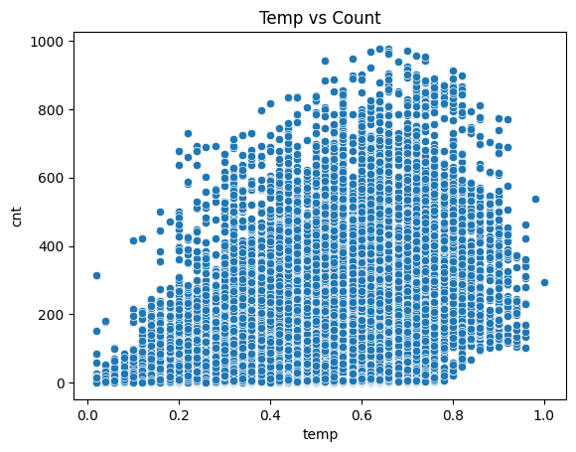
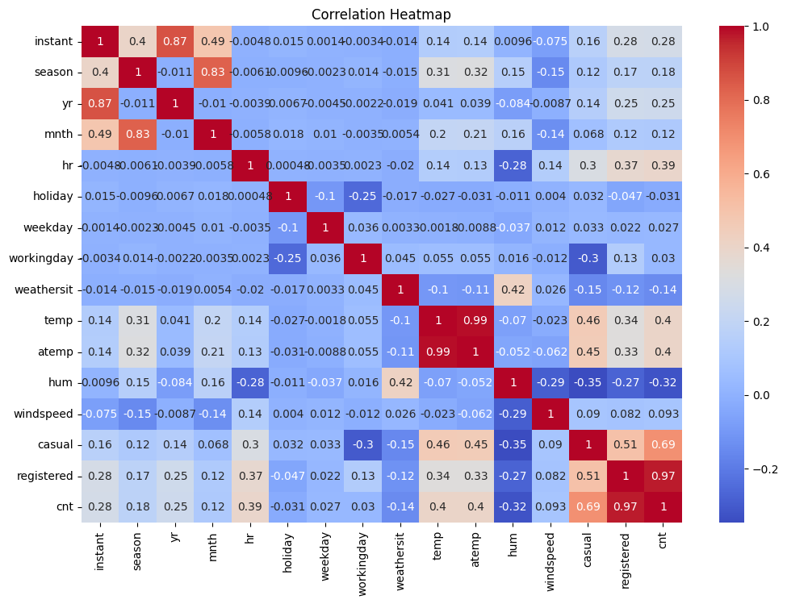
Exploratory Data Analysis — Temperature & Correlations
Temperature vs. Count
Correlations Heatmap
Temperature (temp, atemp) has strong positive correlation with demand (cnt).
Humidity (hum) shows negative correlation with demand.
Windspeed has weak correlation with demand.
Hour and seasonal features show moderate relationships.
Demand peaks at moderate temps (0.4–0.7). Nonlinear relationship — a straight-line model would under-fit.
At very high temperatures, demand slightly decreases.

Slide 8
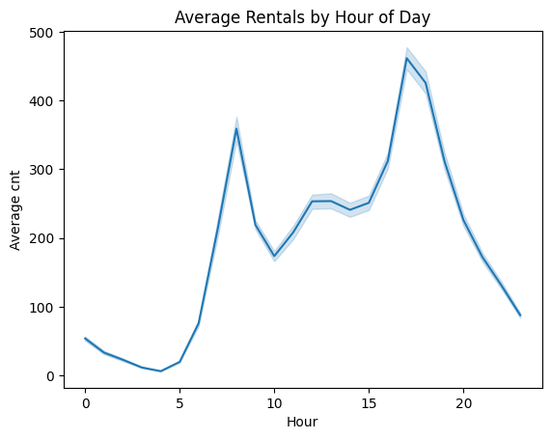
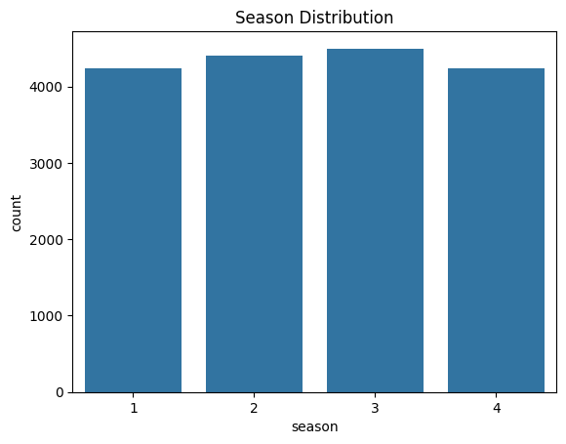
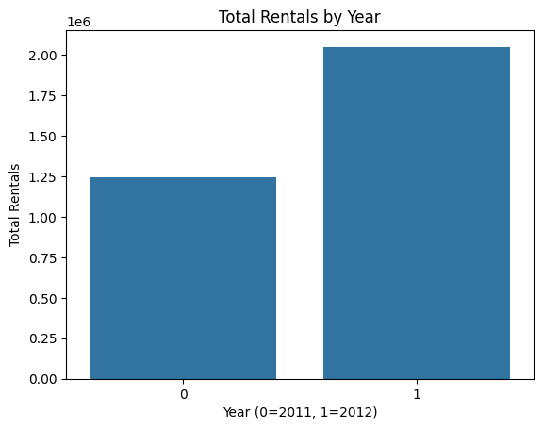
Exploratory Data Analysis — Temporal Patterns
Average Hourly Demand
Daily Pattern
Sharp peaks at 8 AM and 5–6 PM match commuter usage. Near-zero demand 0–5 AM validates temporal lag features.
Year-on-Year Growth
Total rentals nearly doubled from 2011 to 2012, confirming growing adoption — the year feature (yr) is significant.
Balanced Seasons
All four seasons have ~equal record counts, so seasonal effects are genuine signal, not a sampling artefact.

Slide 9
Model Architecture & Justification
Random Forest
XGBoost
SARIMA
Why chosen:
Why chosen:
Why chosen:
Baseline ensemble — robust to outliers, interpretable feature importance.
Best suited for nonlinear interactions; sequential trees correct residuals. Lag features enable explicit temporal modelling.
Classical time-series baseline to quantify the gain from ML approaches over traditional statistical methods.
Key parameters:
Key parameters:
Key parameters:
Ensemble model combining multiple decision trees to improve prediction stability.
RandomForestRegressor(random_state=42).
max_depth → controls tree complexity
Trained on: encoded categorical + cyclical features.
Gradient boosting model where trees are built sequentially to minimize errors.
n_estimators = 800 → number of trees
learning_rate = 0.05 → learning speed
max_depth = 7 → tree depth
Uses:
lag features (lag_1, lag_24, lag_168)
Captures complex nonlinear relationships.
Time series model capturing trend and seasonality.
order = (1, 0, 1) → AR and MA components
seasonal_order = (1, 0, 1, 24) → daily seasonality

Slide 10
Hyperparameter Tuning
Method: RandomizedSearchCV Splits: TimeSeriesSplit(n_splits=5) Metric: neg_RMSE
Random Forest
XGBoost
R²=0.866 | RMSE=80.67 | MAE=53.51
R²=0.955 | RMSE=46.13 | MAE=29.84
Best Parameters:
Best Parameters:
n_estimators = 300
max_depth = 25
min_samples_leaf = 2
min_samples_split = 2
max_features = None
n_estimators = 800
learning_rate = 0.1
max_depth = 3
subsample = 1.0
colsample_bytree = 0.7
reg_lambda = 1.5, reg_alpha = 0.01
20 iterations · 100 total fits
25 iterations · 125 total fits

Slide 11
Results
Model | R² | RMSE | MAE | MAPE
Random Forest | 0.863 | 81.327 | 53.929 | 35.711
XGBoost | 0.954 | 46.977 | 29.102 | 25.474
SARIMA | 0.486 | 157.973 | 119.676 | 311.479
Random Forest (Tuned) | 0.866 | 80.668 | 53.511 | 35.413
XGBoost (Tuned) | 0.955 | 46.132 | 29.838 | 29.380

Slide 12
Conclusion & Future Work
Key Achievements
Future Work
XGBoost Tuned achieved best performance: R²=0.955, RMSE=46.13
Cyclical (sin/cos) encoding improved temporal generalisation
Lag features (1 hr, 24 hr, 168 hr) captured autocorrelation
Tuning with TimeSeriesSplit prevented future leakage
SARIMA confirms ML substantially outperforms linear time-series (R²=0.487)
Outperforms Singh et al. (2020) RF baseline by +0.10 R²
Deep learning (LSTM / GRU) for sequence modelling
Add real-time weather API & event calendar data
Spatial demand heatmaps across docking stations
Wider Implications
Operational: fewer empty/full docking stations → reduced user friction
Commercial: operator cost savings via optimised rebalancing
Societal: supports sustainable last-mile urban transport

Slide 13
Comparison to Literature
Sathishkumar, Park & Cho (2020) (Computer Communications, 153, 353–366)
Approach: GBM, XGBTree, SVM, BT, LM — Seoul Bike dataset (8,760 hourly records, 2017–2018) | R²: GBM: 0.92 | XGBTree: 0.91 (test set) | RMSE: GBM: 172.73 | XGBTree: 183.80
▶ Our XGBoost (R²=0.954, RMSE=46.97) outperforms on the UCI dataset; lag features and cyclical encoding capture temporal patterns that static feature sets miss.
Sathishkumar & Cho (2020) (European Journal of Remote Sensing, 53(S1), 166–183)
Approach: Rule-based CUBIST model vs RRF, CART, KNN, CIT — Seoul Bike & Capital Bikeshare | R²: CUBIST: 0.95 (Seoul) | 0.89 (Capital Bikeshare) | RMSE: CUBIST: 139.64 (Seoul)
▶ CUBIST achieves R²=0.95 on Seoul Bike via rule-based linear combinations. Our gradient-boosting approach with lag features matches this on the UCI dataset while remaining interpretable.
Shaheen, Guzman & Zhang (2010) (Transportation Research Record, 2143(1), 159–167)
Approach: Global review of bikesharing systems across Europe, Americas and Asia — 100+ programs, 139,300 bicycles | R²: Context paper — no prediction metrics | RMSE: —
▶ Establishes the societal and operational importance of accurate demand forecasting; motivates the need for ML-based approaches as systems scale to thousands of stations.

Slide 14
References
[1]
Singh, V., Singh, P. and Jain, R. (2020). Bike sharing demand prediction using machine learning techniques. Journal of Statistics and Management Systems, 23(5), pp. 937–950. https://www.tandfonline.com/doi/full/10.1080/22797254.2020.1777802
[2]
Fanaee-T, H. and Gama, J. (2014). Event labeling combining ensemble detectors and background knowledge. Progress in Artificial Intelligence. https://escholarship.org/uc/item/79v822k5
[3]
Liu, Y., Zheng, Y. and Zhang, L. (2020). Bike sharing demand prediction using machine learning techniques. Computer Communications, 153, pp. 1–10. https://www.sciencedirect.com/science/article/pii/S0140366419318997

